Slide 1
All on Azure SQL Data Warehouse
Abdul Rasheed Feroz Khan
Microsoft MVP – Azure

Slide 2

About the Instructor
Founder & Director – CodeSizzler
Microsoft Most Valuable Professional – Azure
C# Corner Most Valuable Professional
Microsoft Certified Trainer
8 Years of experience as Cloud Consultant
Azure – AWS – GCP – IoT – Machine Learning – Cognitive Services – Bot – Xamarin – Big Data
Consultant for Accenture, Adobe, Boeing, Deloitte., Infosys, Johnson Controls, Microsoft, Wipro, etc.,
Abdul Rasheed Feroz Khan

Slide 3
About the Instructor
C# Corner Most Valuable Professional
Microsoft Certified Trainer
Senior Technical Evangelist – Cloud Factory, CodeSizzler
Azure – AWS – GCP – IoT – Big Data – Machine Learning – Cognitive Services
Kishore Chowdary

Slide 4
Agenda – Day 1
09:30 AM - 11:00 AM | Introducing Azure SQL Data Warehouse | What is Azure SQL Data Warehouse?
 |  | Provisioning Azure SQL Data Warehouse
 |  | Configuring Azure SQL Data Warehouse
 |  | Parallel Processing
11:00 AM – 11:30 AM | Break
11:30 AM – 01:00 PM | Designing & Querying Data Warehouses | Table design – Partitioning – Indexes – Statistics – Elastic Query – Tools for Monitoring Queries
01:00 PM – 02:00 PM | 60 Mins Lunch Break
02:00 PM – 03:30 PM | Integrating & Ingesting Data | Loading data into Azure SQL Data Warehouse
03:30 PM – 04:00 PM | Break
04:00 PM - 05:30 PM | Integrating & Ingesting Data | Loading data into Azure SQL Data Warehouse

Slide 5
Azure SQL Data Warehouse

Slide 6
What is SQL Data Warehouse?
SQL Data Warehouse is a cloud-based Enterprise Data Warehouse (EDW) that leverages Massively Parallel Processing (MPP) to quickly run complex queries across petabytes of data.
Notes:
Azure Functions is actually built on top of the WebJobs SDK

Slide 7
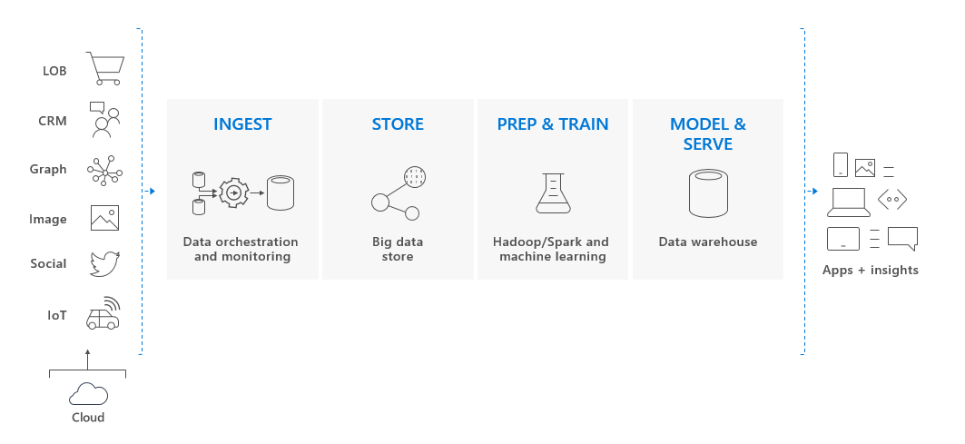
Key Components of Big Data Solution
Notes:
SQL Data Warehouse is a key component of an end-to-end big data solution in the Cloud.

Slide 8
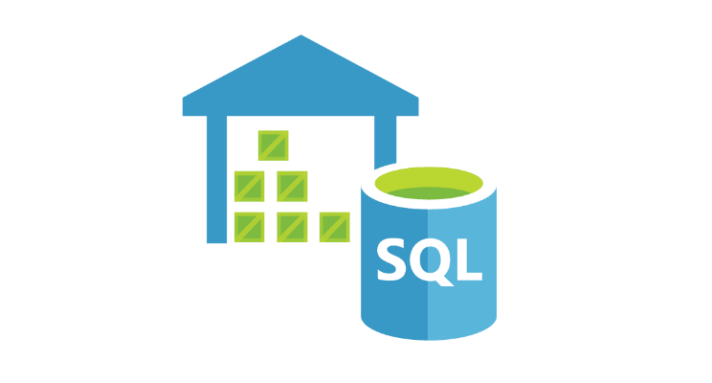
Why Azure SQL Data Warehouse?
Scale and performance
Trusted and secure
Elastic and extensible
Seamless integration
Notes:
Scale and performance
Make data go further. SQL Data Warehouse gives you a cloud solution which removes limits to scale and performance. With tight Azure Databricks integration, bring together any data type at any scale.
Elastic and extensible
Optimise data warehouse performance and lower costs by scaling compute and storage independently. Pause your data warehouse to ensure you are only paying for the resources you need.
Trusted and secure
Count on enhanced security features and industry-leading compliance. SQL Data Warehouse is compliant across more than 50 certifications and available across global regions.
Seamless integration
Combine with leading data integration and BI solutions. SQL Data Warehouse is compatible across Microsoft and leading data integration and visualisation vendors such as Tableau and Informatica.

Slide 9

Service Capabilities
Limitless concurrency
Lightning-fast provisioning
Advanced security
Process any kind of data
Truly elastic by design
Fully managed infrastructure

Slide 10
MPP Architecture

Slide 11
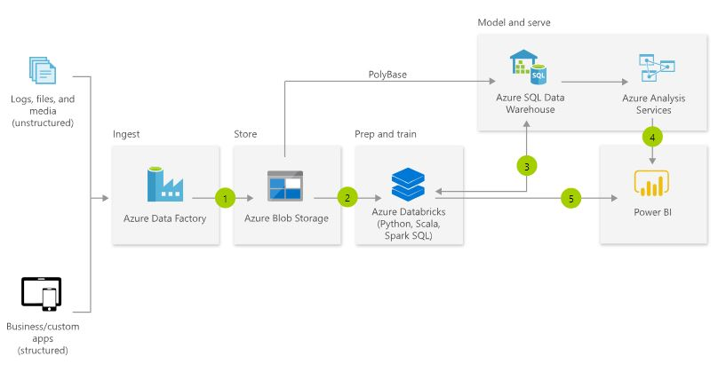
Modern Data Warehouse
Notes:
A modern data warehouse lets you bring together all your data at any scale easily and to get insights through analytical dashboards, operational reports or advanced analytics for all your users.

Slide 12
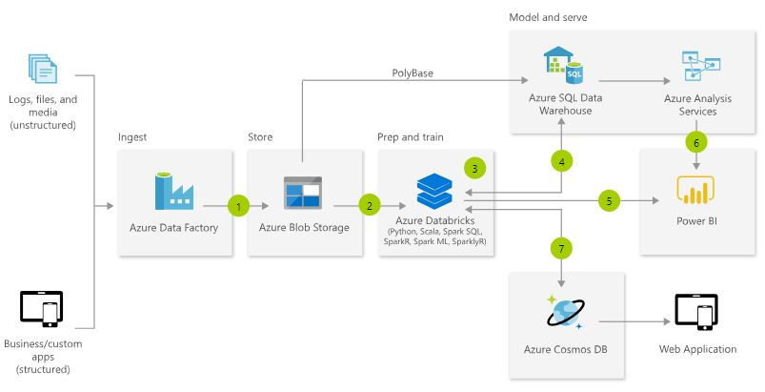
Advanced Analytics on Big Data
Notes:
Transform your data into actionable insights using the best-in-class machine learning tools. This architecture allows you to combine any data at any scale and to build and deploy custom machine learning models at scale.

Slide 13
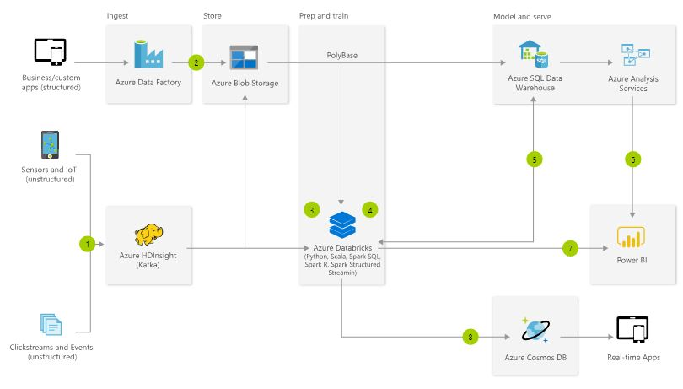
Real-time Analytics
Notes:
Get insights from live streaming data with ease. Capture data continuously from any IoT device or logs from website clickstreams and process it in near-real time.

Slide 14
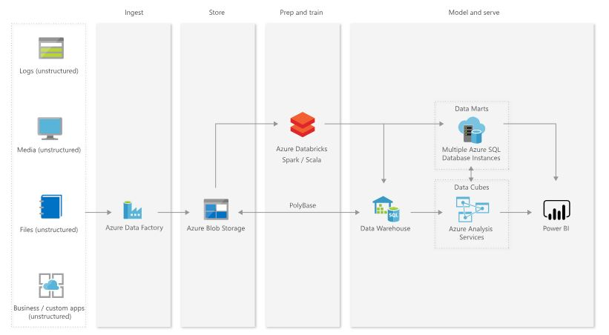
Hub and Spoke Architecture for BI
Notes:
Use the hub and spoke architecture to achieve the scale you want, at the price and performance level you decide. This architecture also provides resource isolation and advanced security features.

Slide 15
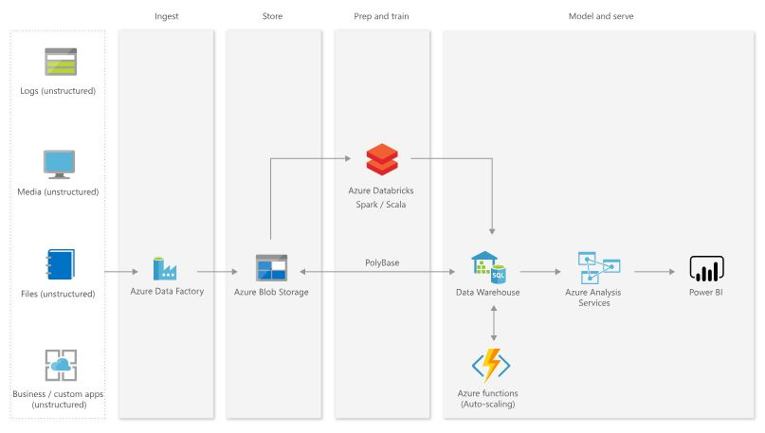
Auto-Scaling Cloud Data Warehouse
Notes:
With Azure Functions, you can take full advantage of the elasticity of Azure SQL Data Warehouse and optimise your cost by auto-scaling.

Slide 16
Pricing
SQL Warehouse is available with two pricing tiers namely,
Compute-optimised Gen1
Compute-optimised Gen2

Slide 17
Pricing - Compute-optimised Gen1
SERVICE LEVEL | DWU | PRICE
DW100 | 100 | ₹79.96/hour
DW200 | 200 | ₹159.92/hour
DW300 | 300 | ₹239.87/hour
DW400 | 400 | ₹319.83/hour
DW500 | 500 | ₹399.79/hour
DW600 | 600 | ₹479.74/hour
DW1000 | 1000 | ₹799.57/hour
DW1200 | 1200 | ₹959.48/hour
DW1500 | 1500 | ₹1,199.35/hour
DW2000 | 2000 | ₹1,599.14/hour
DW3000 | 3000 | ₹2,398.70/hour
DW6000 | 6000 | ₹4,797.40/hour
Notes:
Separates compute and storage for independent, elastic sizing of resources. Designed for frequent scaling operations to manage compute spend and cloud “burst” scenarios. Offers lowest starting scale point.

Slide 18
Pricing - Compute-optimised Gen2
SERVICE LEVEL | DWU | PRICE
DW1000c | 1000 | ₹798.45/hour
DW1500c | 1500 | ₹1,197.67/hour
DW2000c | 2000 | ₹1,596.89/hour
DW2500c | 2500 | ₹1,996.11/hour
DW3000c | 3000 | ₹2,395.33/hour
DW5000c | 5000 | ₹3,992.22/hour
DW6000c | 6000 | ₹4,790.66/hour
DW7500c | 7500 | ₹5,988.33/hour
DW10000c | 10000 | ₹7,984.43/hour
DW15000c | 15000 | ₹11,976.65/hour
DW30000c | 30000 | ₹23,953.29/hour
Notes:
Includes adaptive caching to deliver enhanced performance for workloads with consistent compute requirements. Designed for intensive workloads with higher query performance and compute scalability needs.

Slide 19
Demo – Creating Azure SQL Data Warehouse

Slide 20
Designing Tables
Determine table category
A star schema organizes data into fact and dimension tables. Some tables are used for integration or staging data before it moves to a fact or dimension table. As you design a table, decide whether the table data belongs in a fact, dimension, or integration table. This decision informs the appropriate table structure and distribution.
Notes:
In computing, the star schema is the simplest style of data mart schema and is the approach most widely used to develop data warehouses and dimensional data marts. The star schema consists of one or more fact tables referencing any number of dimension tables. The star schema is an important special case of the snowflake schmea, and is more effective for handling simpler queries.

Slide 21
Types of Tables
Fact tables
Dimension tables
Integration tables
Notes:
Fact tables contain quantitative data that are commonly generated in a transactional system, and then loaded into the data warehouse. For example, a retail business generates sales transactions every day, and then loads the data into a data warehouse fact table for analysis.
Dimension tables contain attribute data that might change but usually changes infrequently. For example, a customer's name and address are stored in a dimension table and updated only when the customer's profile changes. To minimize the size of a large fact table, the customer's name and address do not need to be in every row of a fact table. Instead, the fact table and the dimension table can share a customer ID. A query can join the two tables to associate a customer's profile and transactions.
Integration tables provide a place for integrating or staging data. You can create an integration table as a regular table, an external table, or a temporary table. For example, you can load data to a staging table, perform transformations on the data in staging, and then insert the data into a production table.

Slide 22
Indexing
SQL Data Warehouse offers several indexing options including clustered columnstore indexes, clustered indexes and nonclustered indexes, and a non-index option also known as heap.

Slide 23
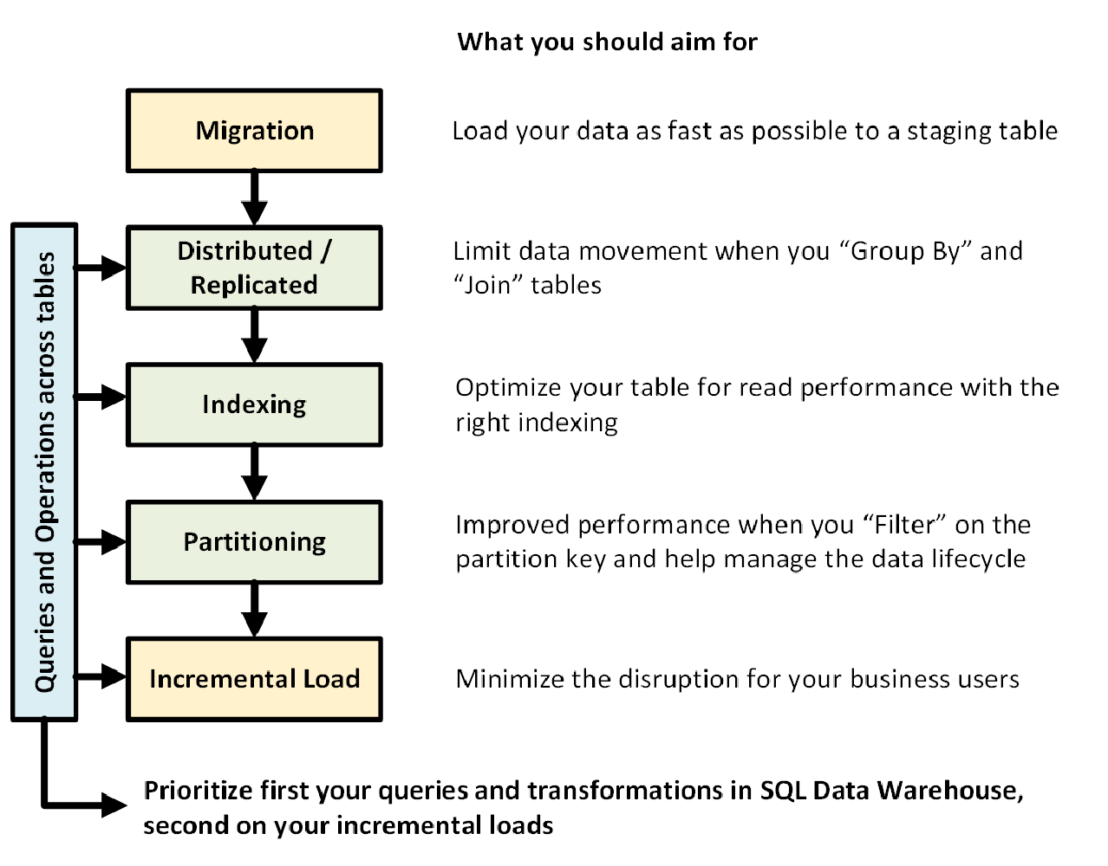
Cheat Sheet for Azure SQL Data Warehouse
Notes:
This cheat sheet provides helpful tips and best practices for building your Azure SQL Data Warehouse solutions. The following graphic shows the process of designing a data warehouse.

Slide 24
Clustered Columnstore Indexes
By default, SQL Data Warehouse creates a clustered columnstore index when no index options are specified on a table. Clustered columnstore tables offer both the highest level of data compression as well as the best overall query performance. Clustered columnstore tables will generally outperform clustered index or heap tables and are usually the best choice for large tables.

Slide 25
Heap Tables
When you are temporarily landing data on SQL Data Warehouse, you may find that using a heap table makes the overall process faster. This is because loads to heaps are faster than to index tables and in some cases the subsequent read can be done from cache. If you are loading data only to stage it before running more transformations, loading the table to heap table is much faster than loading the data to a clustered columnstore table.

Slide 26
Causes for poor Columnstore index quality
If you have identified tables with poor segment quality, you want to identify the root cause. Below are some other common causes of poor segment quality:
Memory pressure when index was built
High volume of DML operations
Small or trickle load operations
Too many partitions

Slide 27
Partitioning tables in SQL Data Warehouse
Table partitions enable you to divide your data into smaller groups of data. In most cases, table partitions are created on a date column. Partitioning is supported on all SQL Data Warehouse table types; including clustered columnstore, clustered index, and heap. Partitioning is also supported on all distribution types, including both hash or round robin distributed.
Partitioning can benefit data maintenance and query performance. Whether it benefits both or just one is dependent on how data is loaded and whether the same column can be used for both purposes, since partitioning can only be done on one column.

Slide 28
Benefits to Loads
The primary benefit of partitioning in SQL Data Warehouse is to improve the efficiency and performance of loading data by use of partition deletion, switching and merging.
Partition switching can be used to quickly remove or replace a section of a table.
While simply inserting, updating, or deleting data can be the most straightforward approach, with a little thought and effort, using partitioning during your load process can substantially improve performance.

Slide 29
Demo – Tables, Partitioning and Indexing

Slide 30
Integration and Ingestion
In addition to its core functionality, SQL Data Warehouse enables users to integrate with many of the other services in Azure. Some of these services include:
Power BI
Azure Data Factory
Azure Machine Learning
Azure Stream Analytics

Slide 31
Power BI
Power BI integration allows you to combine the compute power of SQL Data Warehouse with the dynamic reporting and visualization of Power BI. Power BI integration currently includes:
Direct Connect: A more advanced connection with logical pushdown against SQL Data Warehouse. Pushdown provides faster analysis on a larger scale.
Open in Power BI: The 'Open in Power BI' button passes instance information to Power BI for a simplified way to connect.

Slide 32
Azure Data Factory
Azure Data Factory gives users a managed platform to create complex extract and load pipelines. SQL Data Warehouse's integration with Azure Data Factory includes:
Stored Procedures: Orchestrate the execution of stored procedures on SQL Data Warehouse.
Copy: Use ADF to move data into SQL Data Warehouse. This operation can use ADF's standard data movement mechanism or PolyBase under the covers.

Slide 33
Azure Machine Learning
Azure Machine Learning is a fully managed analytics service, which allows you to create intricate models using a large set of predictive tools. SQL Data Warehouse is supported as both a source and destination for these models with the following functionality:
Read Data: Drive models at scale using T-SQL against SQL Data Warehouse.
Write Data: Commit changes from any model back to SQL Data Warehouse.

Slide 34
Azure Stream Analytics
Azure Stream Analytics is a complex, fully managed infrastructure for processing and consuming event data generated from Azure Event Hub. Integration with SQL Data Warehouse allows for streaming data to be effectively processed and stored alongside relational data enabling deeper, more advanced analysis.
Job Output: Send output from Stream Analytics jobs directly to SQL Data Warehouse.

Slide 35
Demo – Integration Service

Slide 36
Loading data to Azure SQL Data Warehouse

Slide 37
Sources to Load data
The data can be loaded into SQL Warehouse from various databases. Depending on the work environment, these sources will be varying. The sources are,
Azure Data Factory
PolyBase
Stream Analytics

Slide 38
Azure Data Factory
Data Factory, a cloud data integration service, to compose data storage, movement, and processing services into automated data pipelines.

Slide 39
Azure PolyBase
PolyBase is a technology that accesses data outside of the database via the t-sql language. In SQL Server 2016, it allows you to run queries on external data in Hadoop or to import/export data from Azure Blob Storage. Queries are optimized to push computation to Hadoop. In Azure SQL Data Warehouse, you can import/export data from Azure Blob Storage and Azure Data Lake Store.

Slide 40
Azure Stream Analytics
Azure Stream Analytics is an event-processing engine that allows you to examine high volumes of data streaming from devices. Incoming data can be from devices, sensors, web sites, social media feeds, applications, and more. It also supports extracting information from data streams, identifying patterns, and relationships. You can then use these patterns to trigger other actions downstream, like alerts, feed information to a reporting tool, or store it for later use.

Slide 41
Demo – Loading Data into Warehouse from various sources

Slide 42
Star Schema

Slide 43
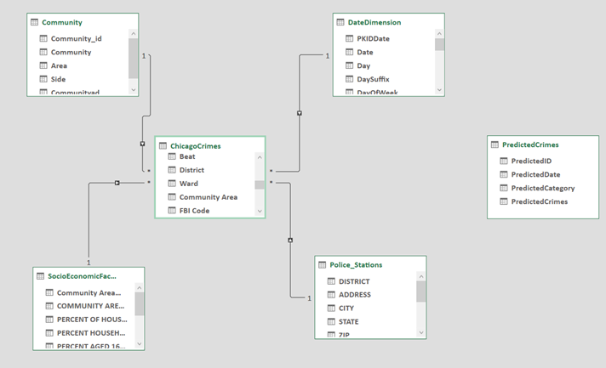
Star Schema
Notes:
This design is primarily focused on providing efficient query operations and there are likely many different opinions on how the data could be better structured. Again, for the purpose of this series of blog posts we're not going to focus on best practices, but rather on getting the job done.
This database design is known in the Data Warehouse world as a star schema.

Slide 44
Dimension based on a Star Schema Design
The structure of a dimension is largely driven by the structure of the underlying dimension table or tables. The simplest structure is called a star schema, where each dimension is based on a single dimension table that is directly linked to the fact table by a primary key - foreign key relationship.

Slide 45
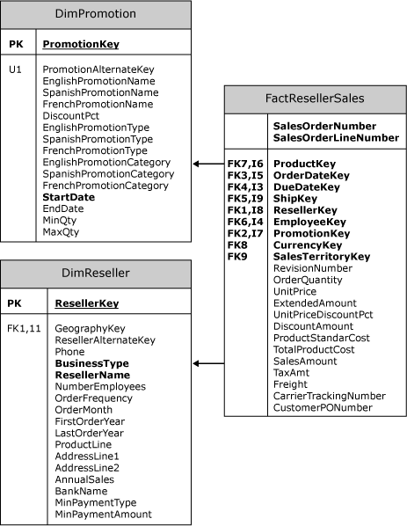
AdventureWorksDW2012 sample database, in which the FactResellerSales fact table is related to two dimension tables, DimReseller and DimPromotion
Notes:
The following diagram illustrates a subsection of the AdventureWorksDW2012 sample database, in which the FactResellerSales fact table is related to two dimension tables, DimReseller and DimPromotion. The ResellerKey column in the FactResellerSales fact table defines a foreign key relationship to the ResellerKey primary key column in the DimReseller dimension table. Similarly, the PromotionKey column in the FactResellerSales fact table defines a foreign key relationship to the PromotionKey primary key column in the DimPromotion dimension table.

Slide 46
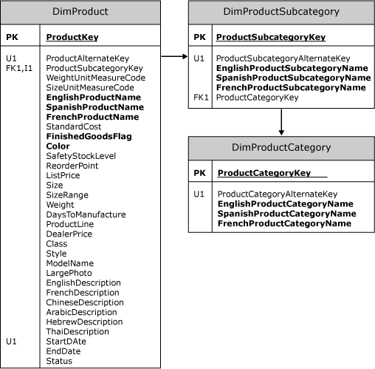
Dimension based on a Snowflake Schema Design
Notes:
Frequently, a more complex structure is required because information from multiple tables is required to define the dimension. In this structure, called a snowflake schema, each dimension is based on attributes from columns in multiple tables linked to each other and ultimately to the fact table by primary key - foreign key relationships. For example, the following diagram illustrates the tables required to completely describe the Product dimension in the AdventureWorksDW sample project.
To completely describe a product, the product's category and subcategory must be included in the Product dimension. However, that information does not reside directly in the main table for the DimProduct dimension. A foreign key relationship from DimProduct to DimProductSubcategory, which in turn has a foreign key relationship to the DimProductCategory table, makes it possible to include the information for product categories and subcategories in the Product dimension.

Slide 47
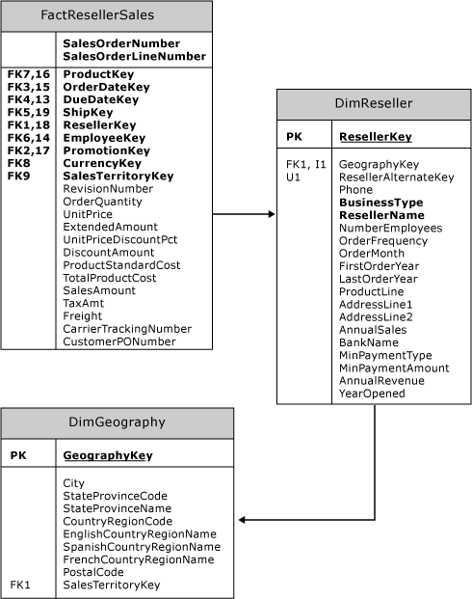
Snowflake Schema versus Reference Relationship
Notes:
Sometimes, you may have a choice between using a snowflake schema to define attributes in a dimension from multiple tables, or defining two separate dimensions and defining a reference dimension relationship between them. The following diagram illustrates such a scenario.
In the previous diagram, the FactResellerSales fact table does not have a foreign key relationship with the DimGeography dimension table. However, the FactResellerSales fact table does have a foreign key relationship with the DimReseller dimension table, which in turn has a foreign key relationship with the DimGeography dimension table. To define a Reseller dimension that contains geography information about each reseller, you would have to retrieve these attributes from the DimGeography and the DimReseller dimension tables. However, in Analysis Services, you can achieve the same result by creating two separate dimensions and linking them in a measure group by defining a reference dimension relationship between the two dimensions. For more information about reference dimension relationships, see Dimension Relationships.
One advantage of using reference dimension relationships in this scenario is that you could create a single geography dimension and then create multiple cube dimensions based on the geography dimension, without requiring any additional storage space. For example, you could link one of the geography cube dimensions to a reseller dimension and another of the geography cube dimensions to a customer dimension. Related topics:Dimension Relationships, Define a Referenced Relationship and Referenced Relationship Properties

Slide 48
SQL Server Analysis Service
All Microsoft SQL Server Analysis Services dimensions are groups of attributes based on columns from tables or views in a data source view. Dimensions exist independent of a cube, can be used in multiple cubes, can be used multiple times in a single cube, and can be linked between Analysis Services.instances. A dimension that exists independent of a cube is called a database dimension and an instance of a database dimension within a cube is called a cube dimension.

Slide 49
SQL Server Analysis Service
All Microsoft SQL Server Analysis Services dimensions are groups of attributes based on columns from tables or views in a data source view. Dimensions exist independent of a cube, can be used in multiple cubes, can be used multiple times in a single cube, and can be linked between Analysis Services.instances. A dimension that exists independent of a cube is called a database dimension and an instance of a database dimension within a cube is called a cube dimension.

Slide 50
Demo – SQL Server Analysis Service

Slide 51
Monitoring Analysis service

Slide 52
Monitoring Analysis Services with SQL Server Profiler
You can use SQL Server Profiler to monitor events generated by an instance of Microsoft SQL Server Analysis Services. By using SQL Server Profiler, you can do the following:
Monitor the performance of an instance of Analysis Services.
Debug Multidimensional Expressions (MDX) statements.
Identify MDX statements that run slowly.
Test MDX statements in the development phase of a project by stepping through statements to confirm that the code works as expected.

Slide 53
High Availability and Scalability
High availability, as a sole objective, can be achieved via server redundancy in a failover cluster Replacement nodes are assumed to have identical hardware and software configuration as the active node. By itself, WSFC gives you high availability, but without scale.
Scalability, with or without availability, is achieved via NLB over read-only databases. Scalability is usually a concern when query volumes are large or subject to sudden spikes.

Slide 54
Securing Database in SQL Data Warehouse

Slide 55
Types of Securities
Connection security
Authentication
Authorization
Encryption

Slide 56
Demo – Security Service

Slide 57
Thank You!

